Slide 1
Today
Lecture 24: Topological superconducting qubits based on Majorana fermion states
Discussion of applications of superconductor materials and devices in five parts:
Overview of the quantum information landscape
Macroscopic quantum phenomena in superconductor devices and superconductor qubits
Decoherence and the emergence of the transmon qubit
Topological superconducting qubits based on Majorana fermion states
S-TI-S Josephson junctions --- a compelling platform
Next time
Lecture 25: S-TI-S Josephson junctions --- a compelling platform for Majorana qubits

Slide 2
Final project
6 groups + individual papers
Explore a topic --- make a set of slides
12 minute presentation on Tuesday, May 10 (last day of class)
Topics:
Conventional SC qubits vs. topological SC qubits
SC qubits vs. ion trap qubits
SC qubits vs. semiconductor qubits
Quantum Supremacy
Superconductors for Quantum Sensing
Quantum computing for discovery of new superconductors
Very unstructured open-ended assignment
Will need to explore the internet to find interesting materials and converge on a theme and focus for your presentation
Emphasis is on learning something and sharing that with all of us --- to me, this assignment will be successful if we all learn some new things and come away with a picture of the potential and challenges of superconductivity in quantum information science and technology
Goal is for everyone to participate --- I would suggest that your team make a plan and have each person contribute some specific component or specific slides to the presentation

Slide 3
Conventional SC qubits vs. topological SC qubits | SC qubits vs. ion trap qubits | SC qubits vs. quantum dot or semiconductor qubits
Abboud, Nick | Birchmier, Rachel Lucille | Fu, Wenning
Beach, Alexander R | Rooke, Spencer George | Ganesan, Vishal
Song, Xiangyu | Wild, Drew Glenn | Peng, Yu-Ting
Suresh Babu, Soorya | Wu, Junyi | Wu, Dufei
Quantum Supremacy | Superconductors for Quantum Sensing | Quantum computing for the discovery of new superconductors/materials
Gabrisko, Nick | Hu, Yuxuan | Apte, Sohm Shailesh
Kim, Dong Beom | Tsai, Pei-Wen | Vaz, Daniel Edward
Montone, Jessica H |  | Zhang, Michael
Wang, Ningdong |  | Zvenigorodsky, Serge
RESEARCH PAPERS
 | Agrawal, Shraddha
 | Baker, Carina Franziska
 | Lennox, Amber Rose Elizabeth
 | Lin, Haoran
 | Ma, Max

Slide 4
Alternate approach to quantum computing --- topological superconducting qubits based on Majorana fermion states
Conventional quantum computing
Topologically-protected quantum computing
Qubits: quantum information stored in superposition of states (two-levels systems = atoms or artificial atoms, e.g. flux qubit, transmons, …)
Computing power from entanglement
Logic operations act on single- or two-qubit states
Superconductivity important for:
protection of quantum states (energy gap)
non-linearity of the Josephson inductance
superconducting devices (e.g. SQUIDs) for readouts
Challenges:
scale-up
decoherence fron energy loss (T₁) and dephasing (T₂)
Qubits: quantum information stored in delocalized Majorana fermions “parity” states or topological edge modes that are protected from fluctuations
Computing power from entanglement and non-Abelian statistics of Majorana fermions
Logic operations by exchange braiding or hybridization
Superconductivity important for:
protection of quantum states (energy gap)
quasiparticle electron-hole symmetry (via Cooper pairs)
proximity effect to induce p-wave superconductivity
Josephson physics (e.g. SQUIDs) for readouts
Challenges:
proving that Majorana fermions exist
braiding and parity readout
Decoherence from parity changes (T_{P})

Slide 5
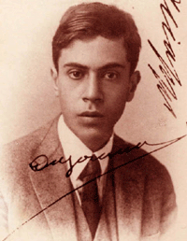
Majorana fermions
Predicted by Ettore Majorana in 1937
Modification of the Dirac equation designed to give only real solutions →
particle that are their own anti-particle
Most of his work concerned whether the neutrino could be a Majorana fermion
(not likely due to “color oscillations” that suggest that neutrinos have a mass but still debated --- should be resolved soon with “double-beta decay” experiments)
Mysteriously disappeared in 1938 --- boarded a ferry for Sicily, thought to be dead for a long time but now believed to have moved to Argentina and lived there until ~1960
Re-gained interest in ~2000 with suggestion that Majorana fermions have a manifestation in condensed matter systems
Best description: Half of a fermion at zero-energy
Intimate connection to topological states of matter that are necessary to support Majorana modes --- these feature protected* surface and edge states that occur at the boundary between topological and trivial phases. Majorana states often (always?) share this property.
* Protected by topological invariants that arise from the band structure

Slide 6
Topological systems that could support Majorana fermions
      Intrinsic chiral materials:
      5/2-quantum Hall state
      Topological superconductors, e.g. Sr₂RuO₄, Nb_{x}Bi₂Se_{3, …}
      Engineer new chiral materials via proximity-coupling:
      spin-orbit semiconductor nanowires + superconductor + magnetic field
      spin-orbit semiconductor (InAs) + superconductor + ferromagnet
      non-centrosymmetric superconductor + ferromagnet
      chains of magnetic atoms on a superconductor
      (your idea here)
      ➢ topological insulator + superconductor
Today
Today
Thursday
SC
TI
SC

Slide 7
Detecting Majorana fermions --- a grand challenge
Many proposed schemes testing various properties of MF states:
spectroscopy --- probe zero energy states via quasiparticle tunneling
noise signatures --- 5/2-quantum Hall states
vortex interference --- Aharonov-Casher effect (Vishveshwara, etc.)
Josephson current–phase relation --- I ~ sin(φ/2) = 4π-periodicity
Josephson interferometry --- critical current vs. magnetic field
Kitaev (2000) + others
S
S
Tunneling by a split fermion rather than by Cooper pairs
MF

Slide 8
Most attention to date --- semiconductor nanowires
B
Semiconductor nanowire
Superconductor
Advantages:
System can be tuned into the topological state with a magnetic field
Majorana fermions are stabilized at the ends of the wire
Parity lifetimes are expected to be long (few other states around)
Can probe zero energy states via quasiparticle tunneling spectroscopy

Slide 9
Most attention to date --- semiconductor nanowires
B
Semiconductor nanowire
Superconductor
Advantages:
System can be tuned into the topological state with a magnetic field
Majorana fermions are stabilized at the ends of the wire
Parity lifetimes are expected to be long (few other states around)
Can probe zero energy states via quasiparticle tunneling spectroscopy
Disadvantages:
Need a large oriented magnetic field to induce the topological state
Majorana fermions are stabilized at the ends of the wire
Challenging to manipulate/braid Majorana fermions

Slide 10
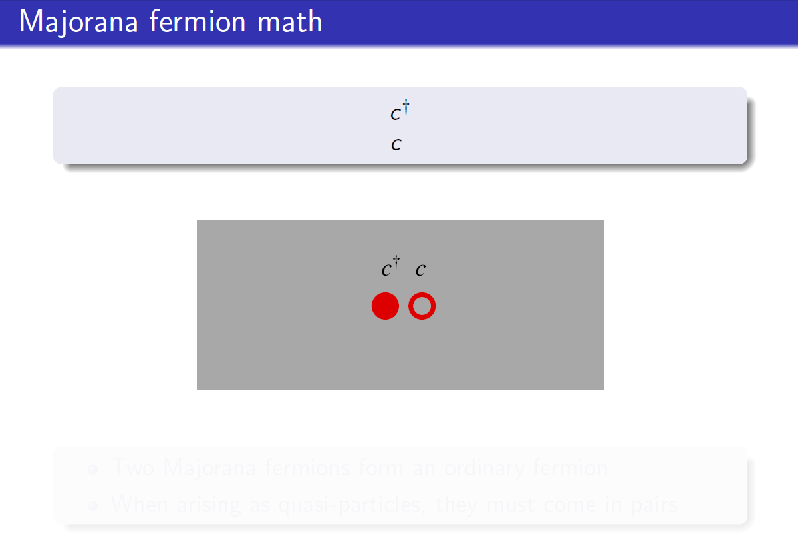

Slide 11
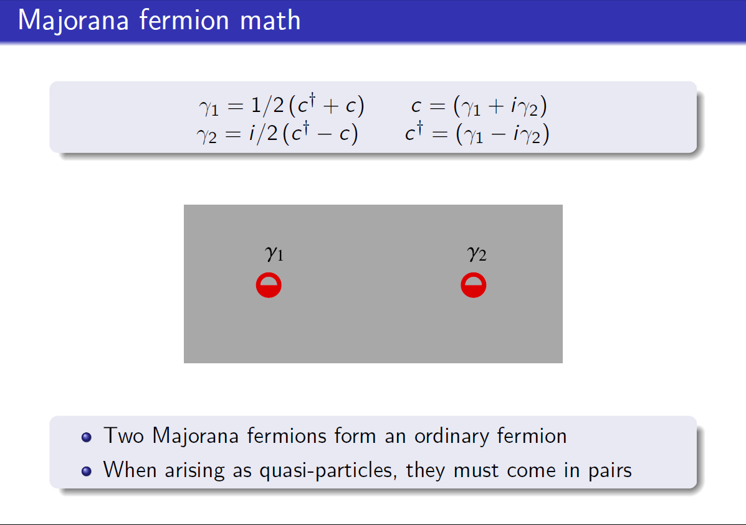


Slide 12
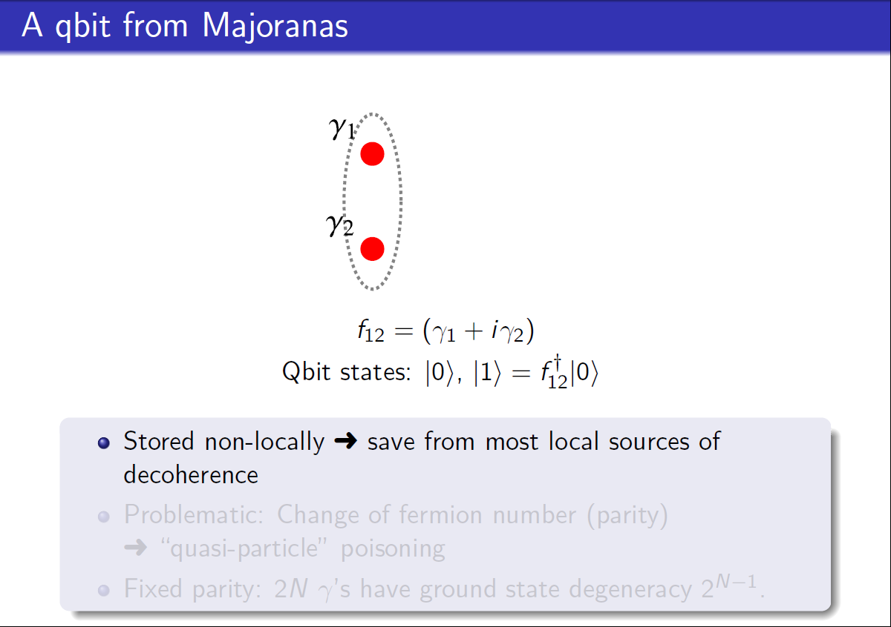
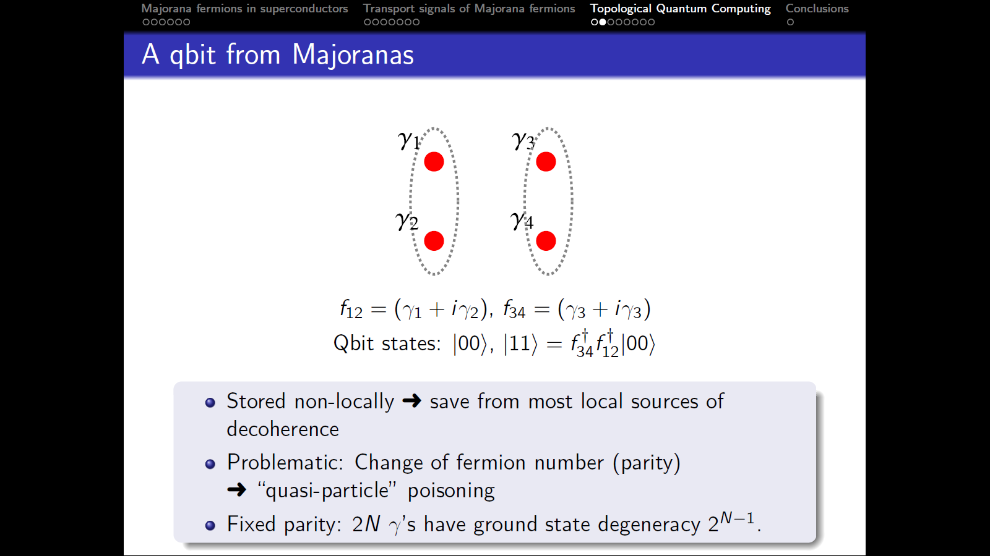
Quantum information stored in parity states = does the pair have a fermion or not
This is not really a qubit because the total parity is fixed
Qubit states:

Slide 13
Need at least two pairs to make a qubit
Qubit states:

Slide 14
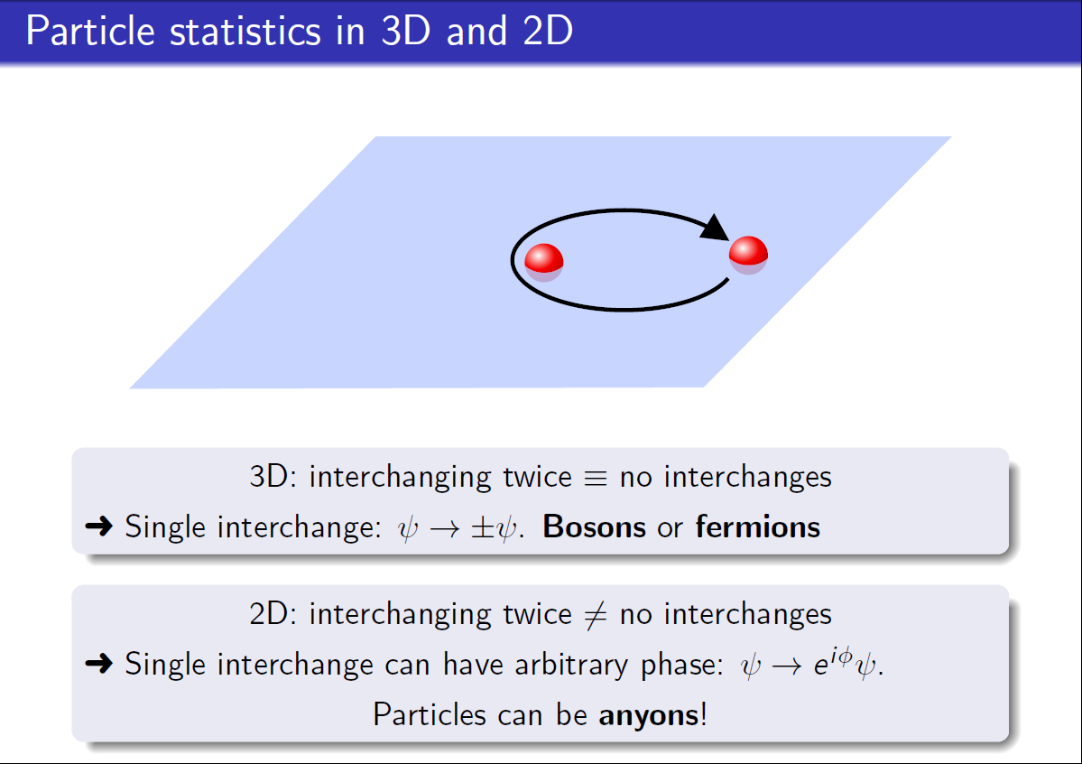

Slide 15
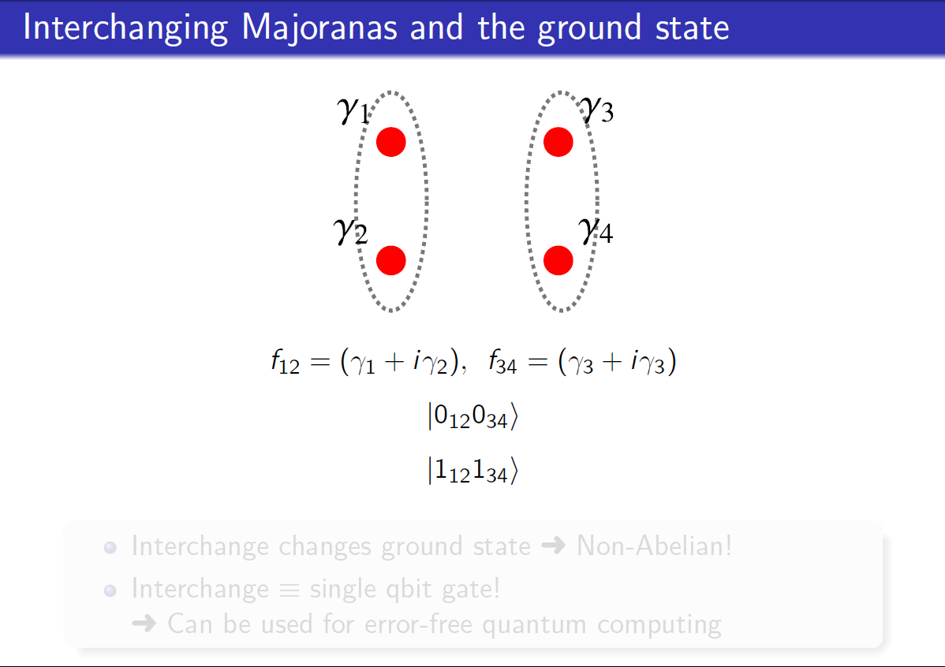

Slide 16
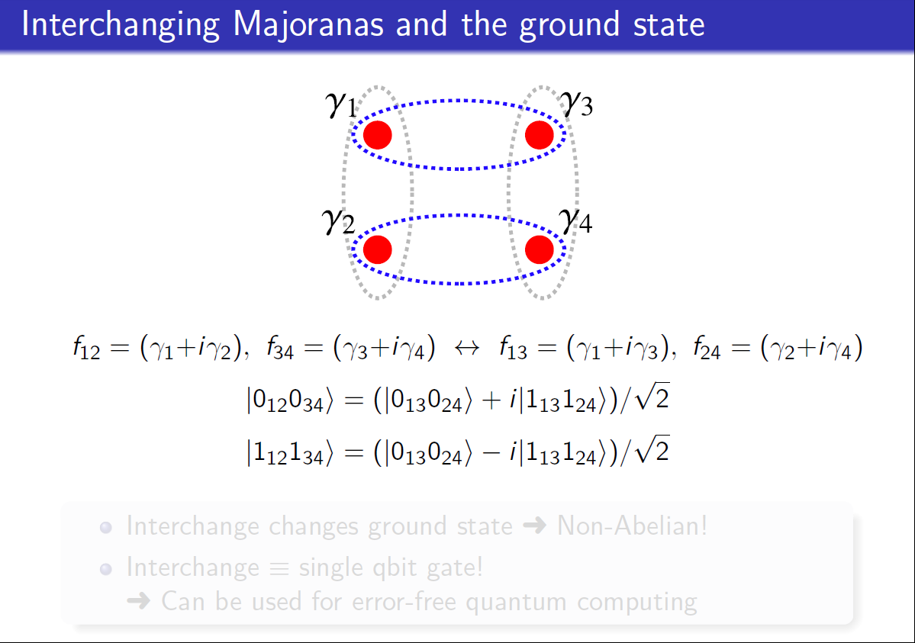

Slide 17
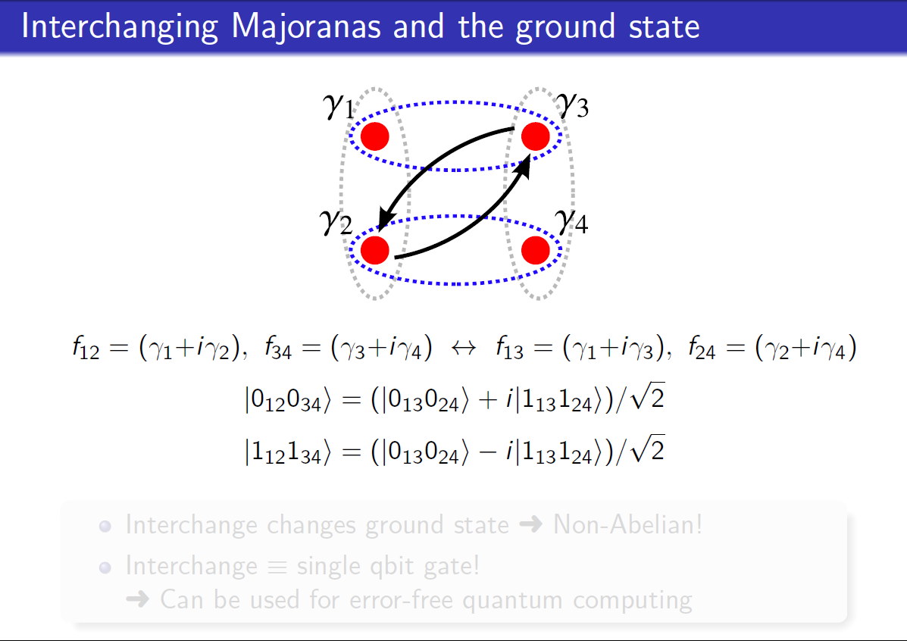

Slide 18
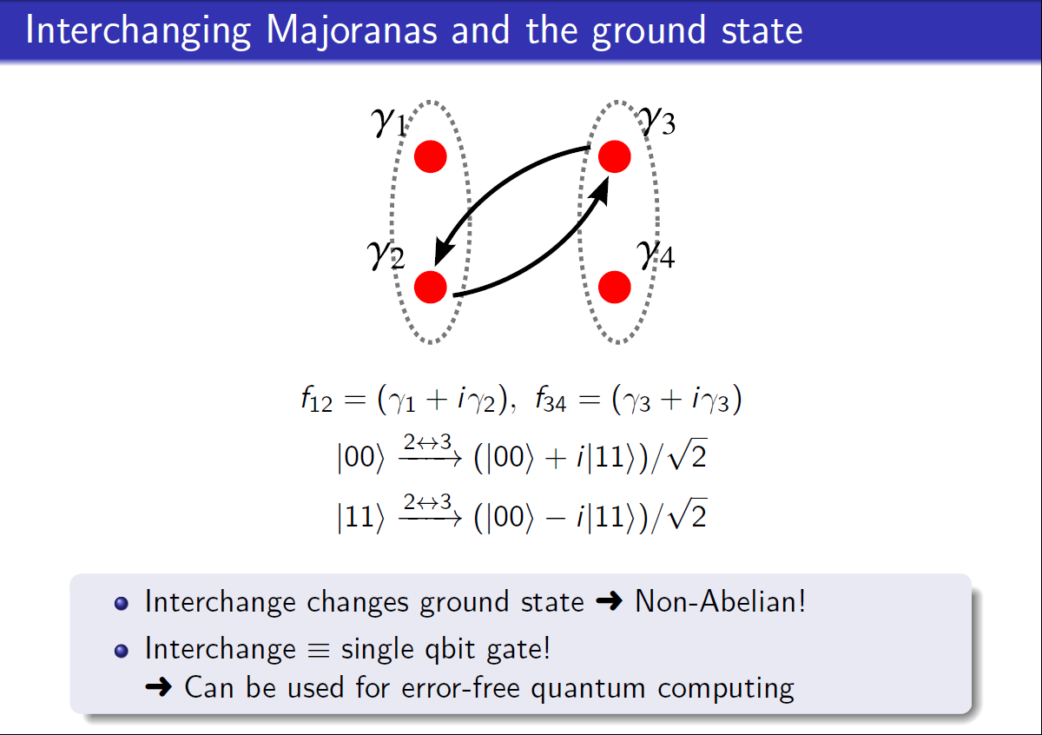

Slide 19
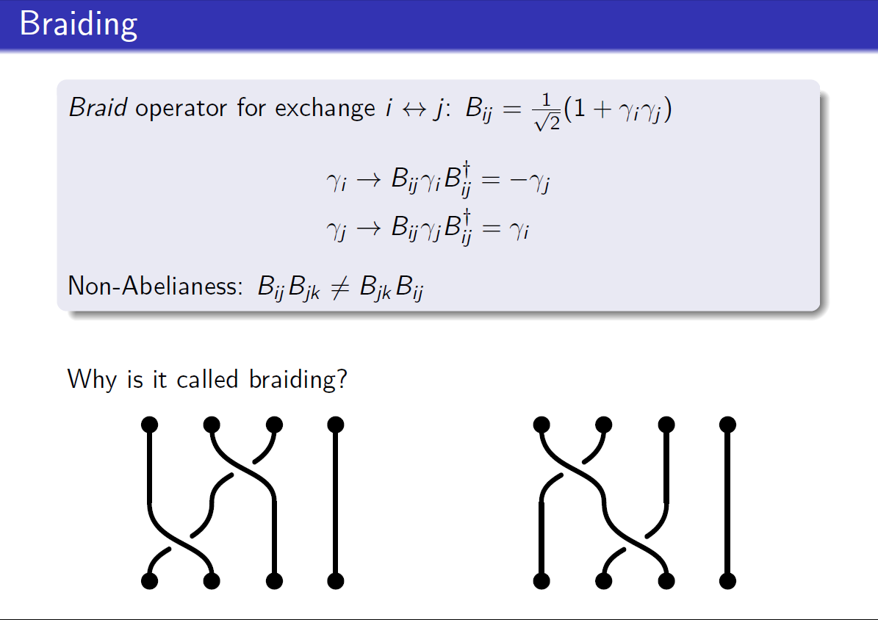

Slide 20
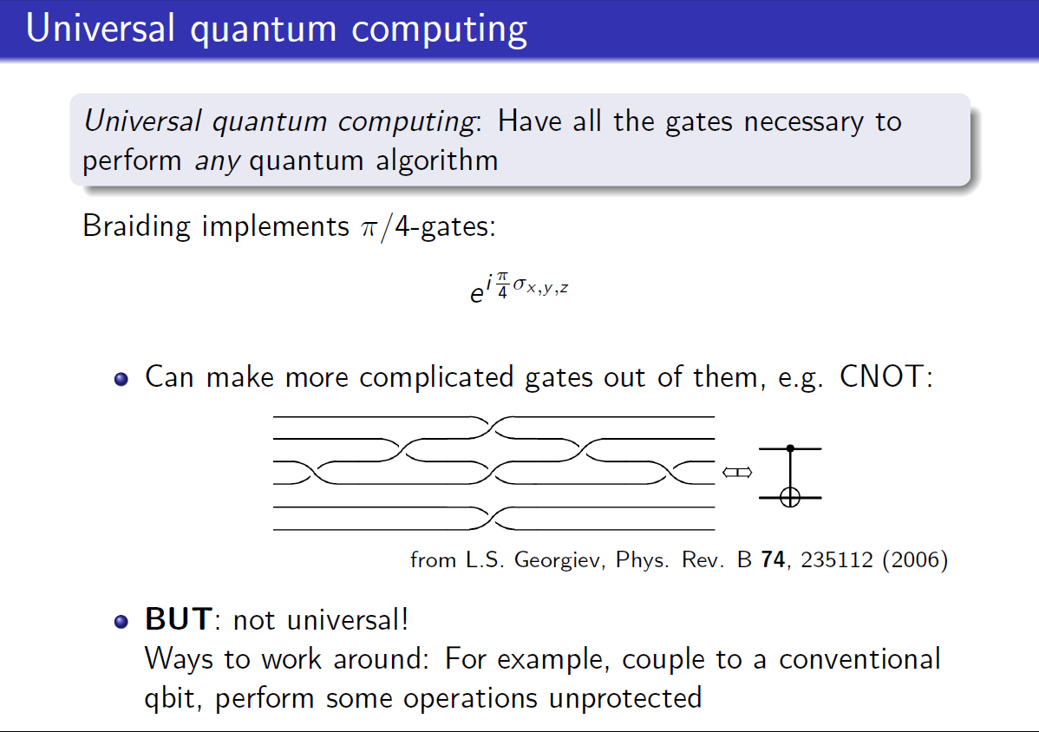

Slide 22
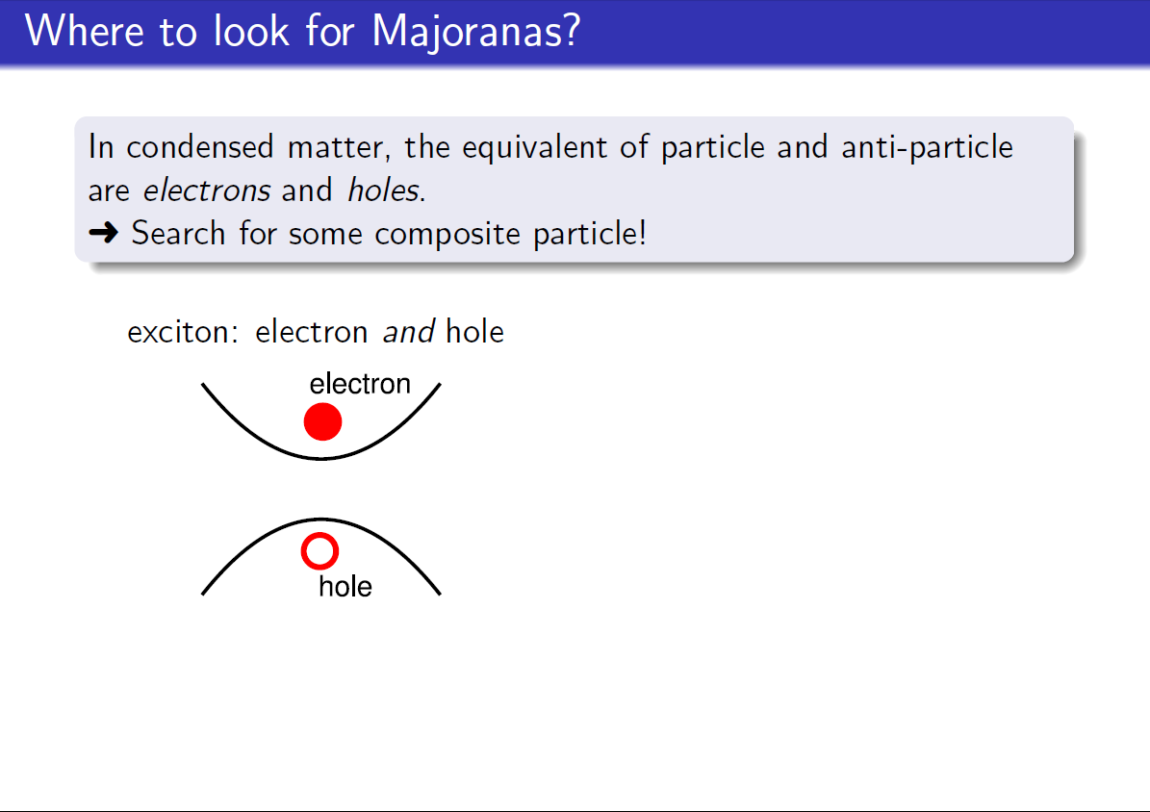

Slide 23
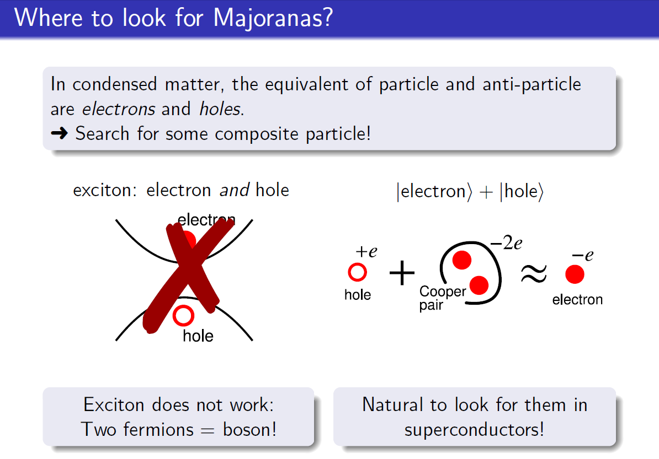

Slide 24
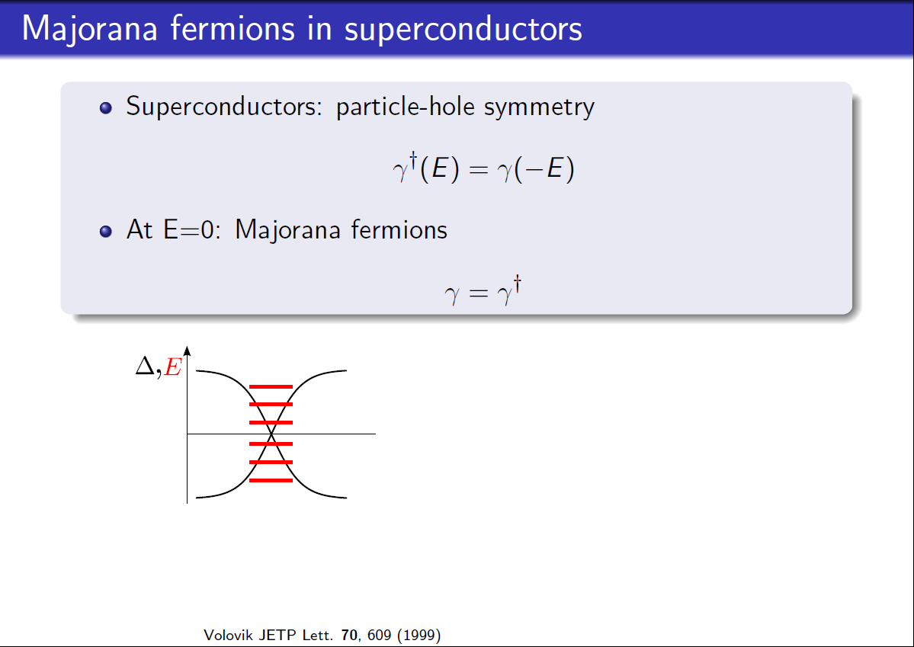

Slide 25
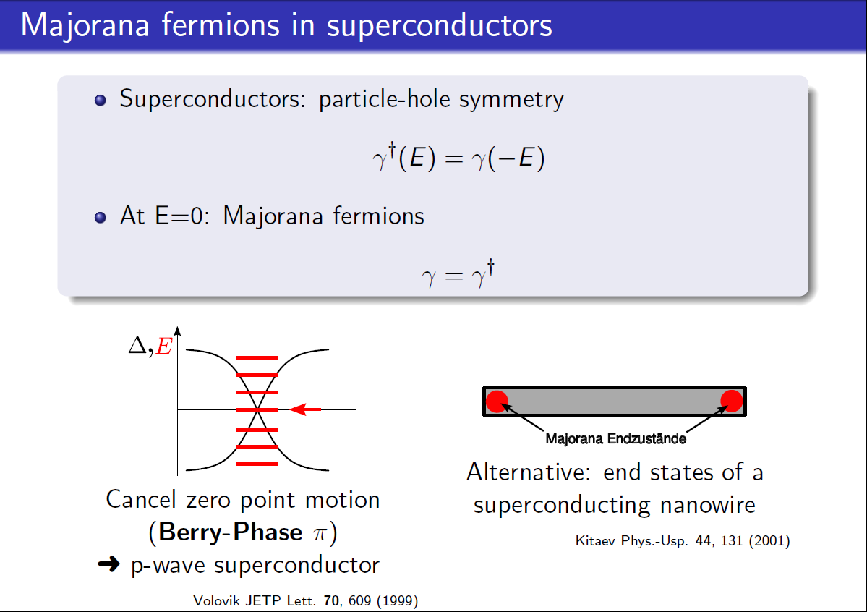

Slide 26
Kitaev model
A.Yu. Kitaev Unpaired Majorana fermions in Quantum Wires, Physics Uspekhi (2001)
Consider a row of fermions expressed in terms of MFs
Treatment by J. Sau, U-Maryland
Consider them paired on each site
Energy of occupied fermion state = μ
Re-pair the MFs --- leaves unpaired MFs separated at the ends of the wire
Energy coupling between fermion states = 2t
Note that the unpaired Majorana states do not appear in the Hamiltonian because they are at zero energy

Slide 27
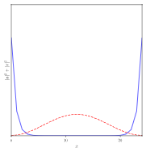
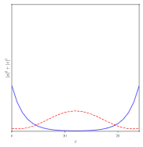
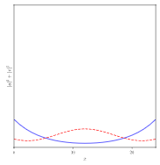

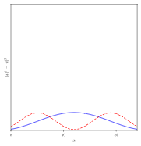
Full Hamiltonian --- converted to Fermion operators:
μ/t = 0
μ/t = 1
μ/t = 1.6
Wavefunction of ground state
Wavefunction of first excited state
μ/t = 1.8
μ/t = 2
μ/t = 3
Majorana state persist for μ/t < 2, protected by the topological nature of the chain --- cannot fuse them without closing the energy gap

Slide 28
Manifestations of the Kitaev model
Chains of atoms
Semiconductor nanowires in a magnetic field
Hamiltonian engineering --- combine ingredients to achieve a topological state that can support Majorana fermions

Slide 29
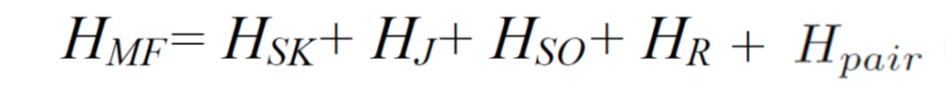
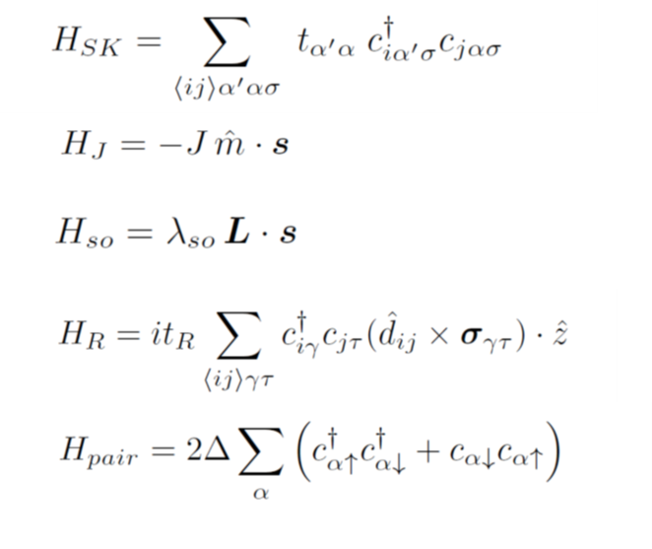
atoms on lattice
magnetic moments
atomic spin-orbit coupling
Rashba spin-orbit coupling
superconductivity

Slide 30

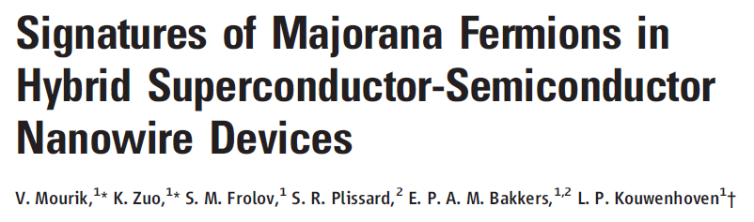
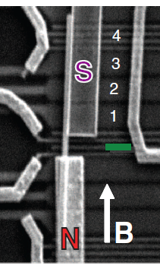
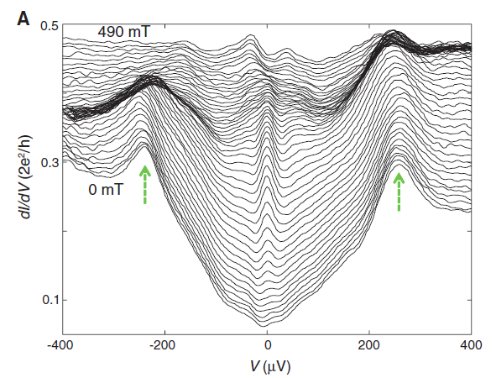
Magnetic field provides Zeeman splitting necessary to induce a topological state in a nanowire proximity-coupled to a superconductor
Majorana fermions nucleate at the ends of the nanowire in narrow field range
Probe density-of-states by tunneling

Slide 31
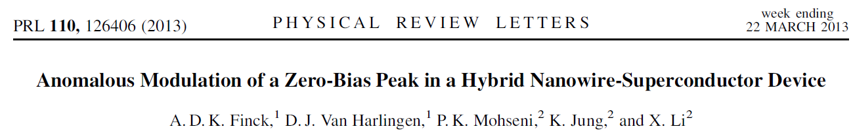
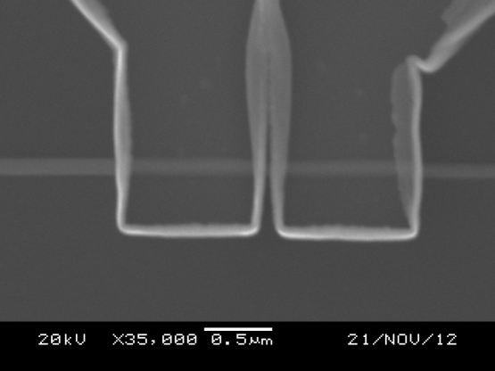
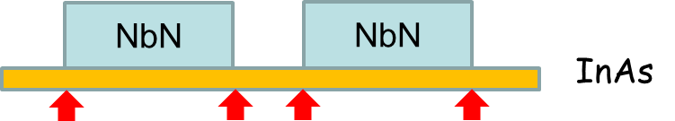
Evidence for hybridization of MFs with gate voltage
NbN
NbN
NW
InAs
InAs nanowire:
100 nm diameter, ~3-4 μm long
NbN leads:
1 μm wide, 150 nm separation

Slide 32
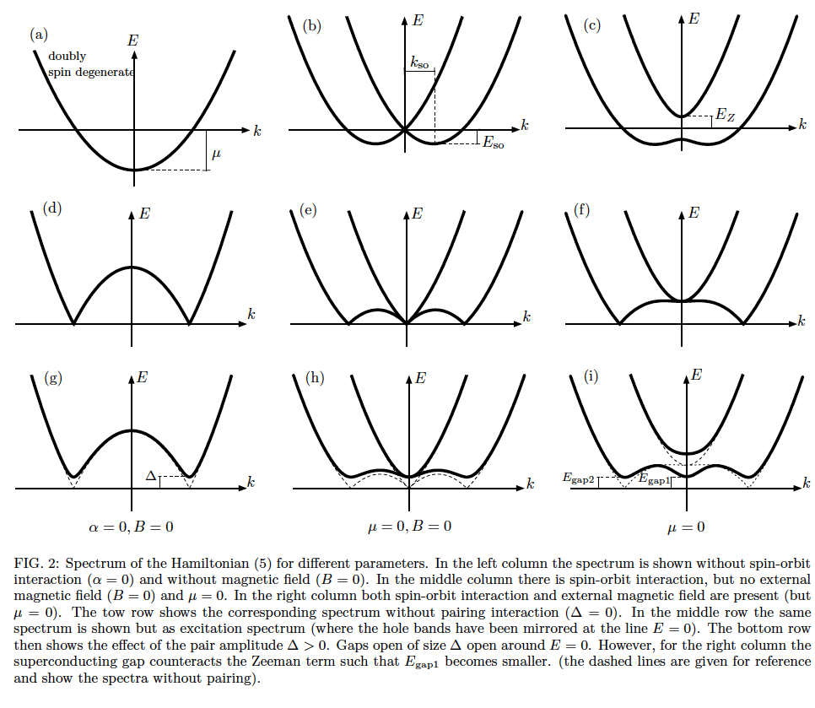
Majorana recipe:
One-dimensional wire
Spin-orbit interaction
Superconductivity
Magnetic field
Lutchyn, Sau, Das Sarma, PRL 2010
Oreg, Refael, von Oppen, PRL 2010

Slide 33
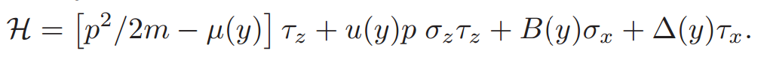
Hamiltonian engineering --- combine ingredients to achieve a topological state that can support Majorana fermions
Oreg, Refael, von Oppen PRL 2010

Slide 34
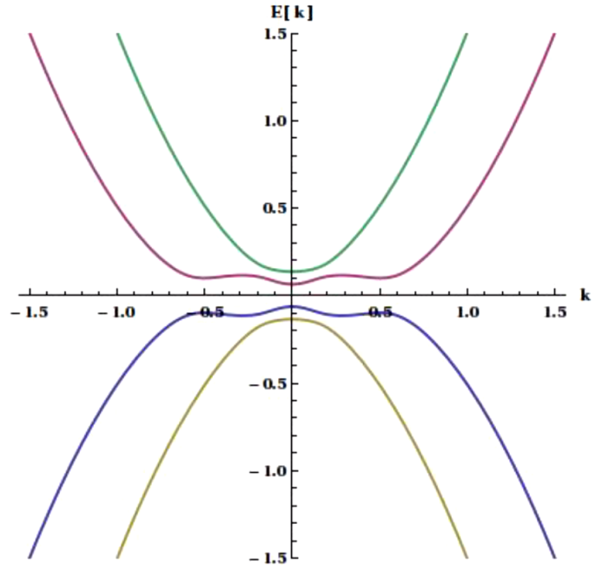
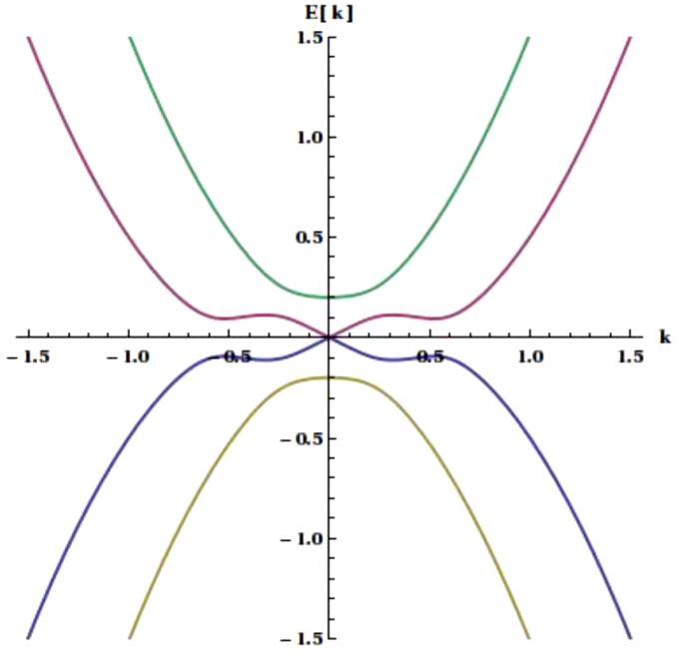
Topological Transition
E_{Z} < Δ
E_{Z} = Δ
E_{Z} > Δ
Trivial Superconductor
“positive gap”
Majorana
“zero gap”
Topological Superconductor
“negative gap”

Slide 35
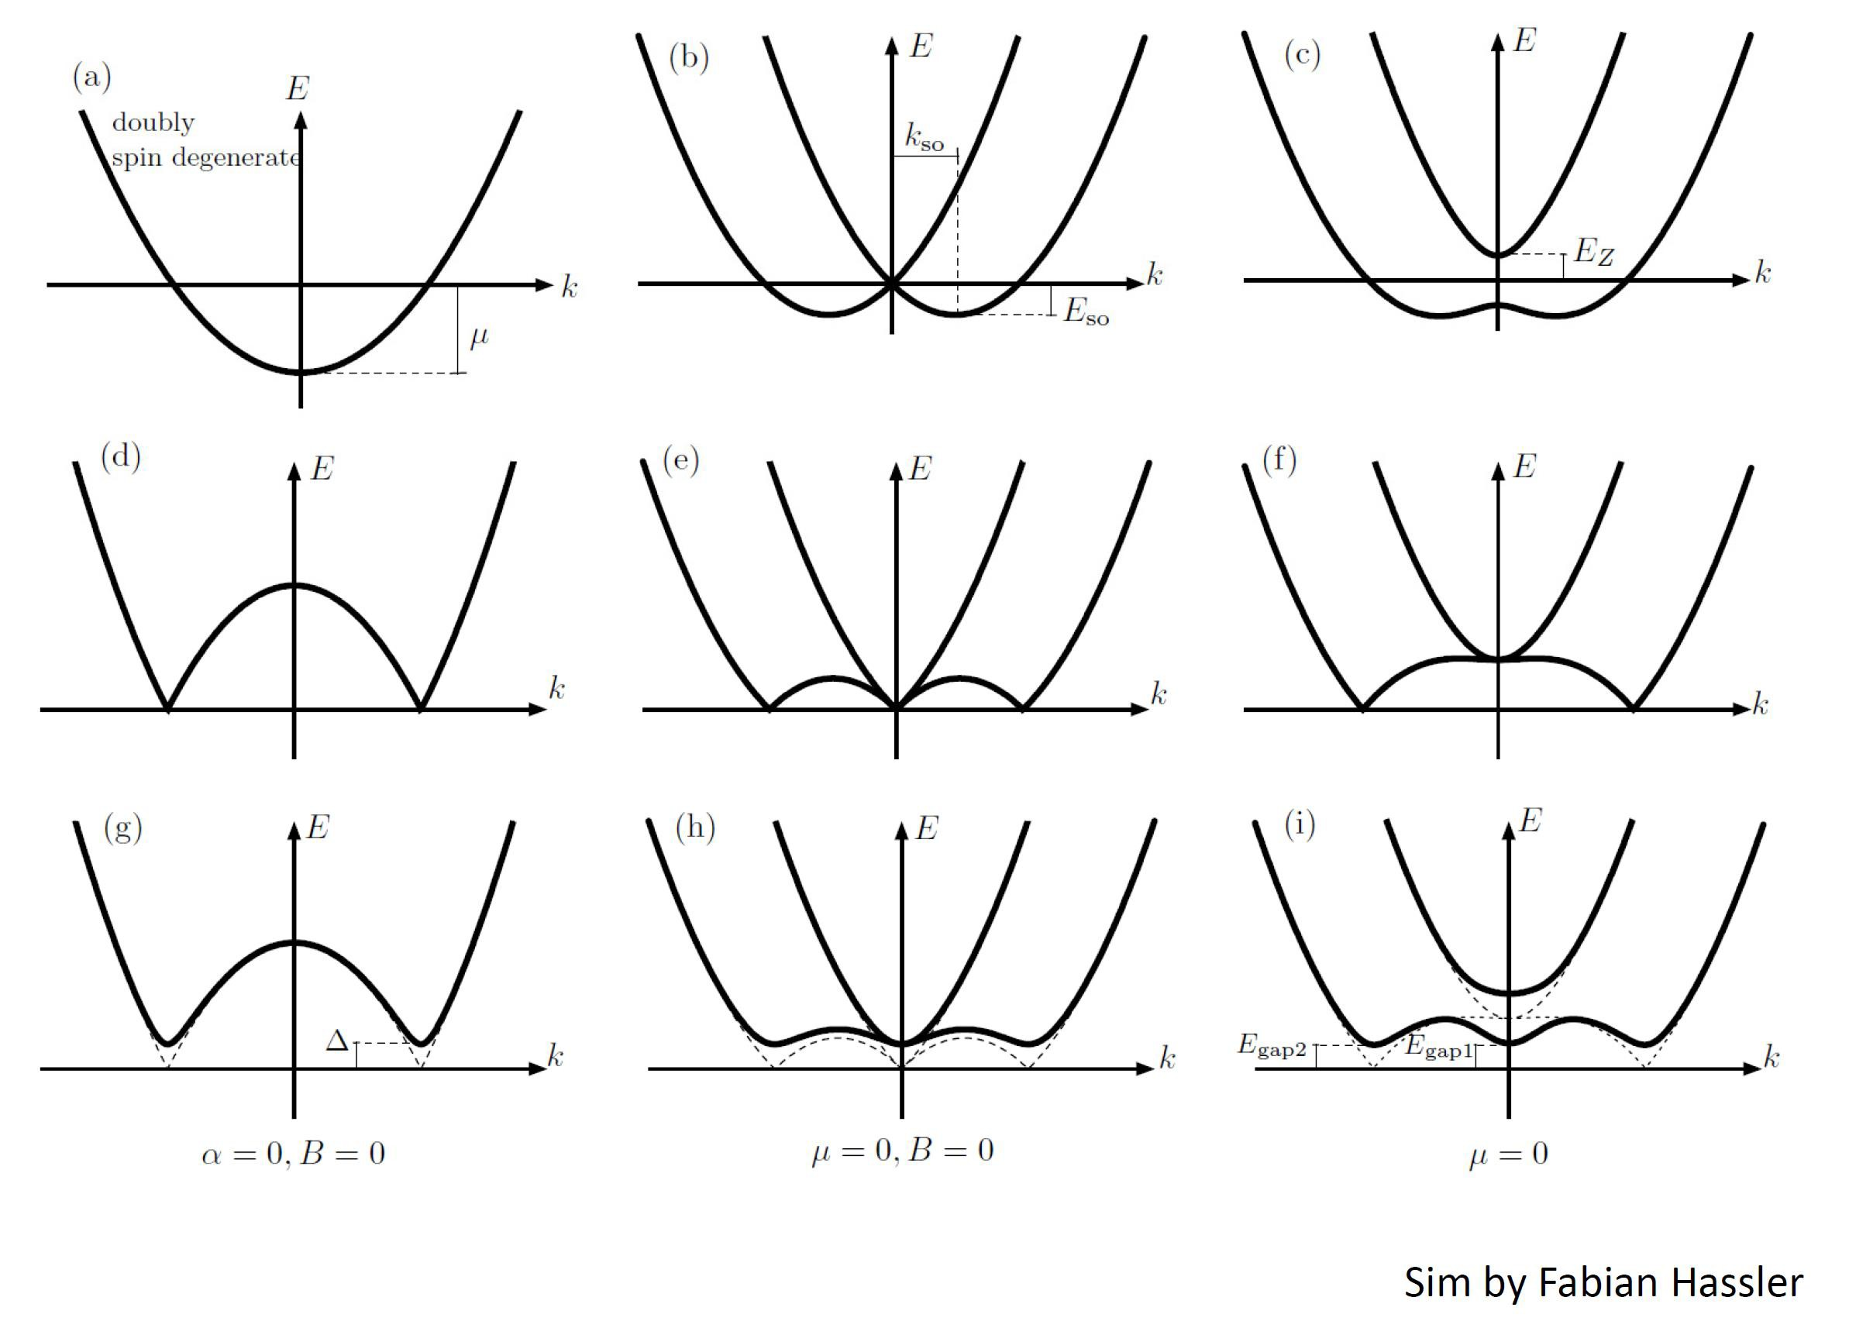

Slide 36
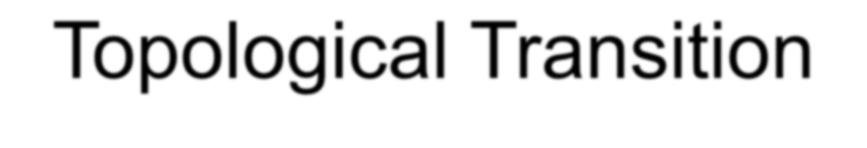
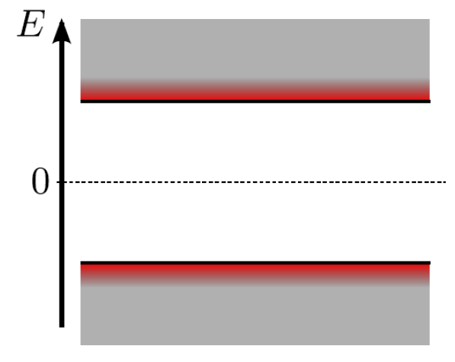
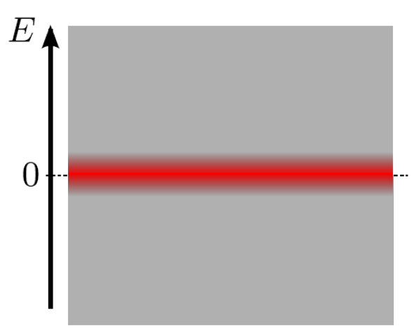
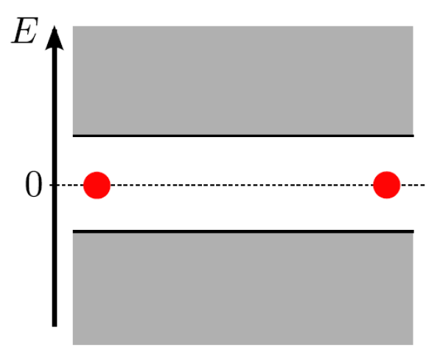
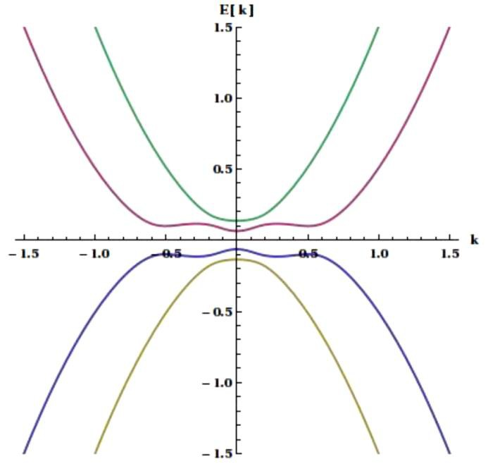
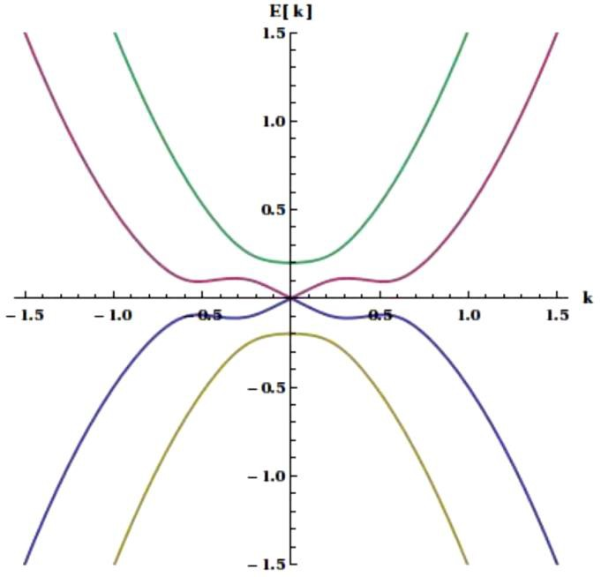
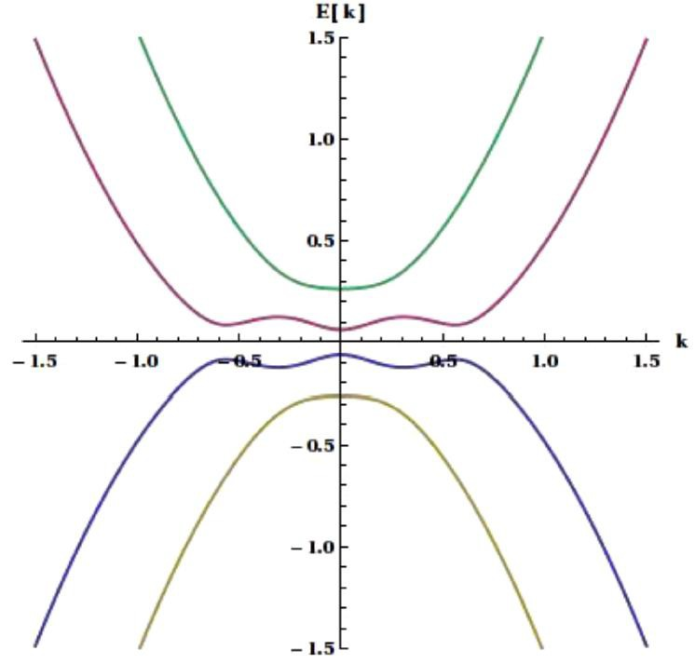
E_{Z} < Δ
E_{Z} = Δ
E_{Z} > Δ
Trivial Superconductor
“positive gap”
Majorana
“zero gap”
Topological Superconductor
“negative gap”

Slide 37
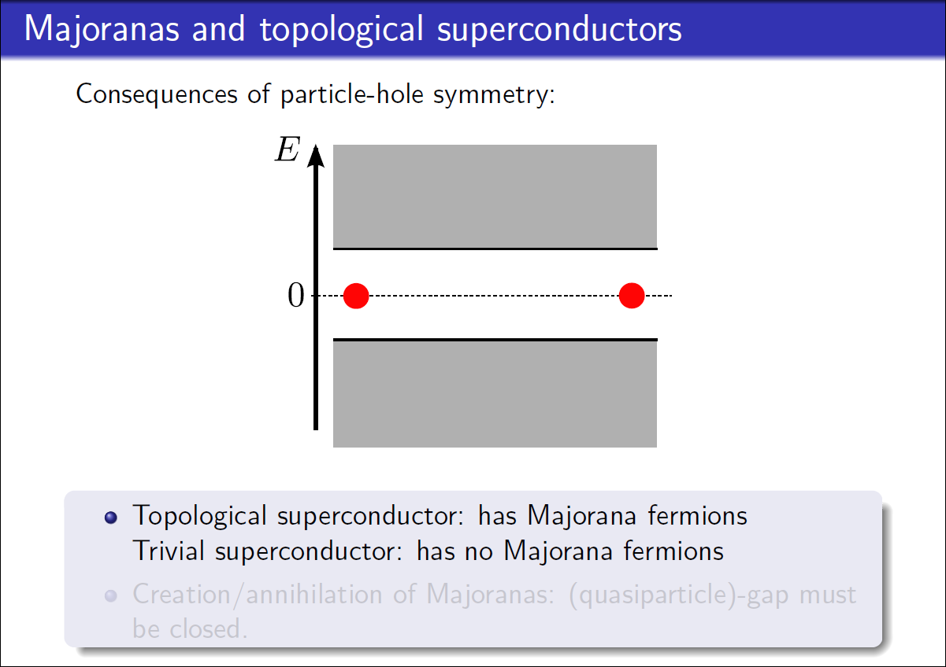

Slide 38
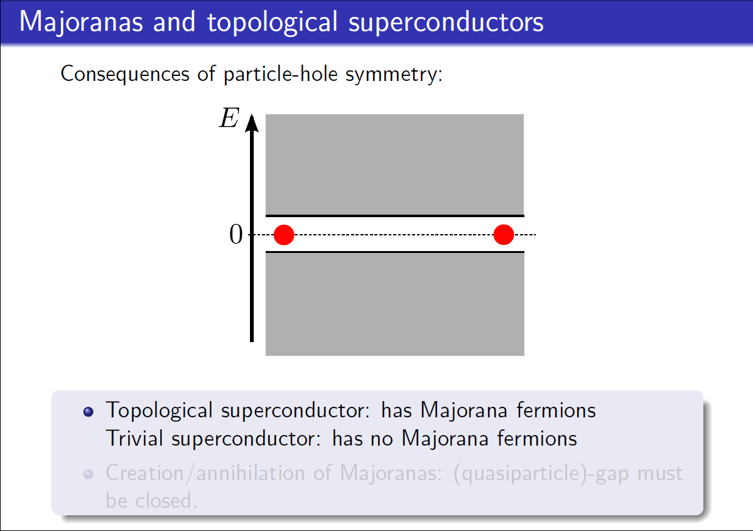

Slide 39
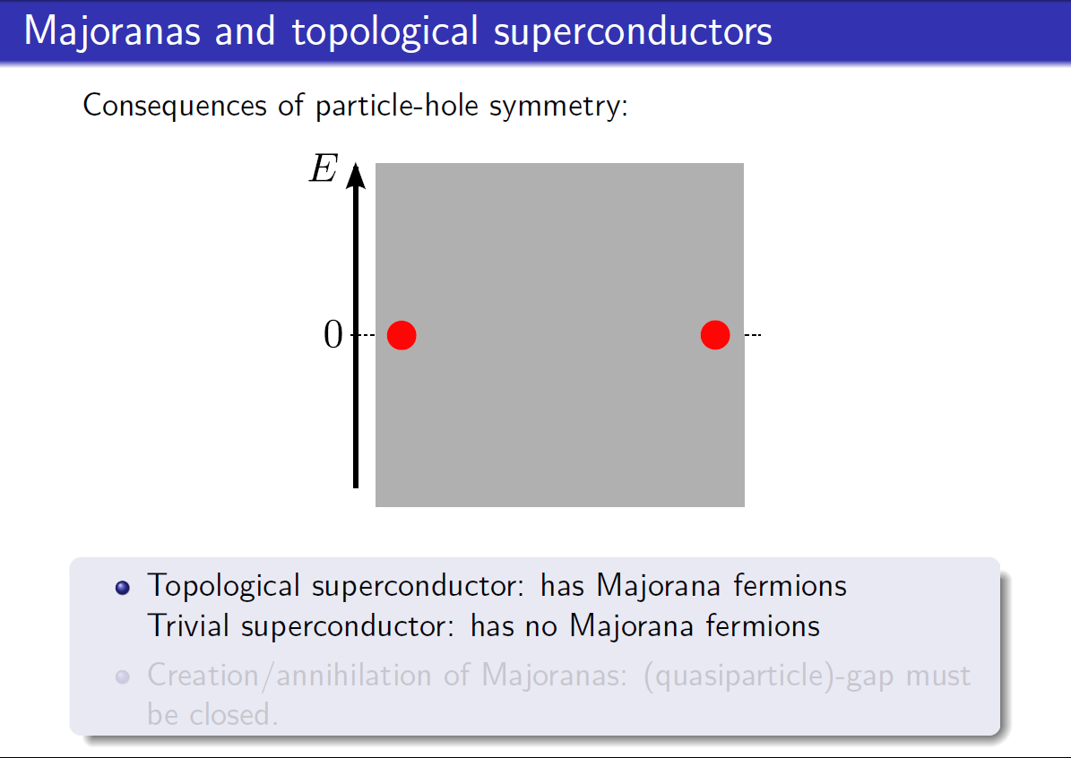

Slide 40
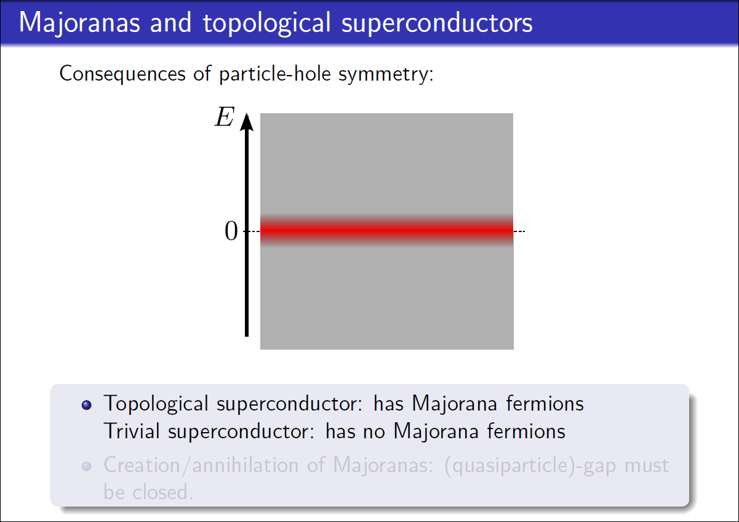

Slide 41
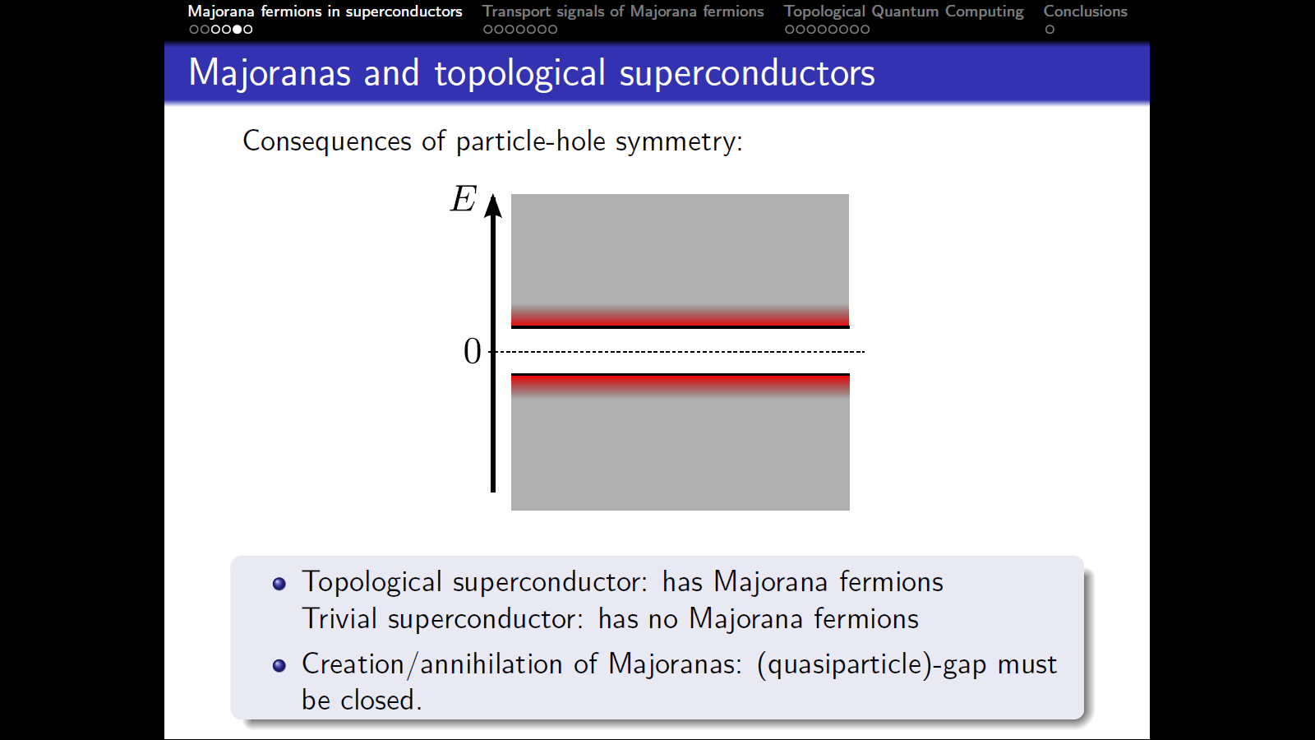

Slide 42
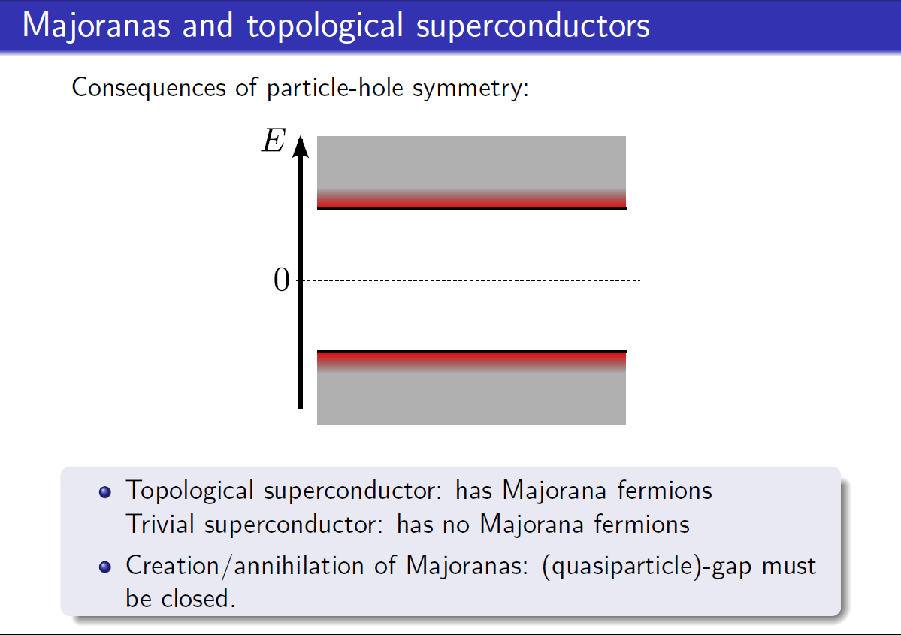

Slide 44
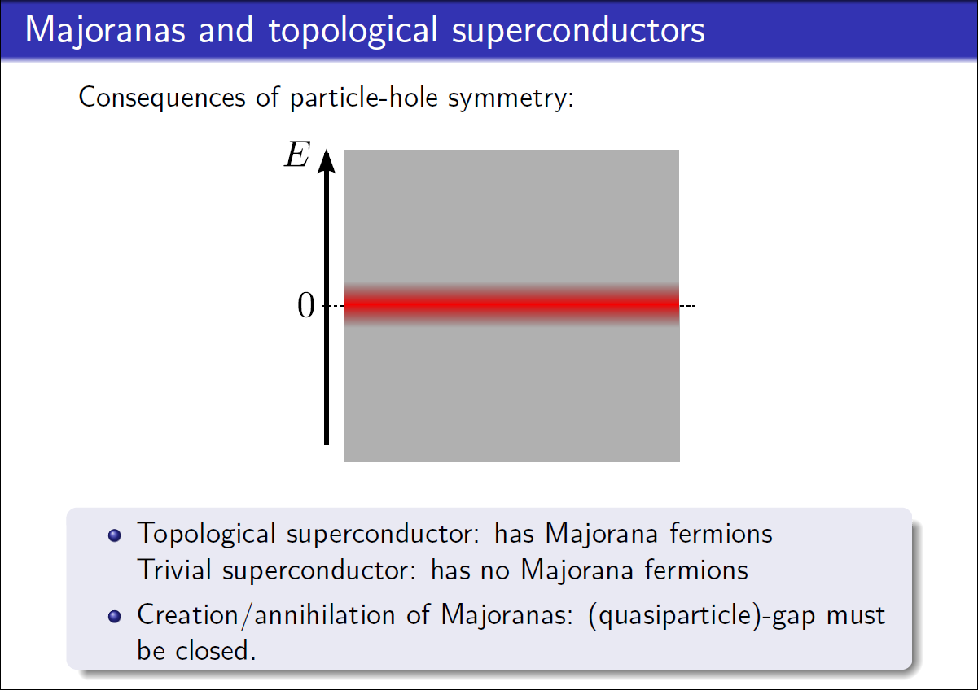

Slide 45
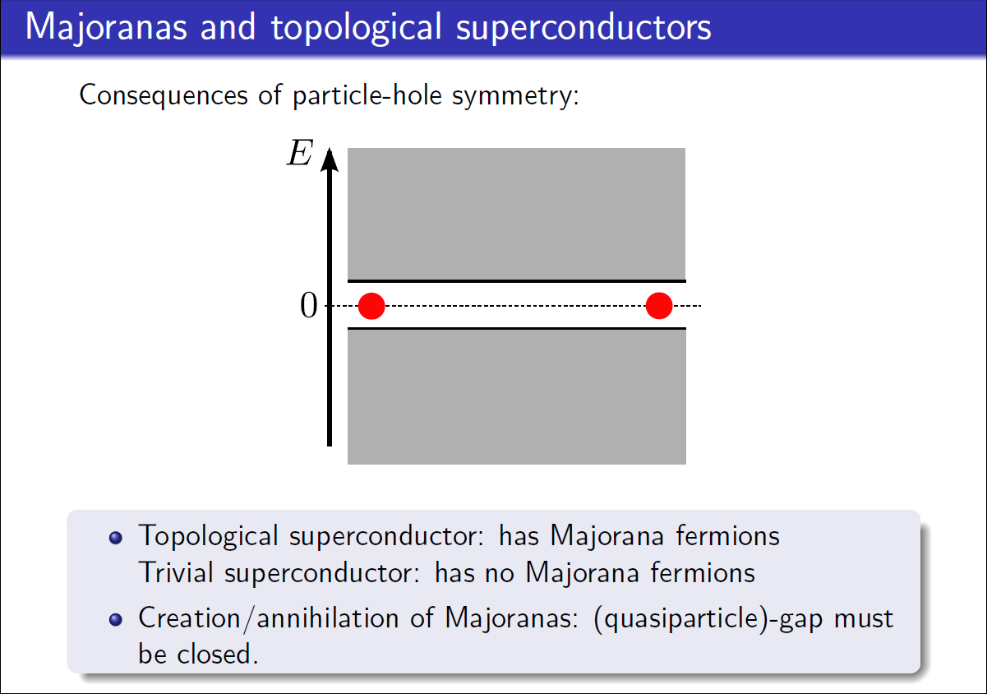

Slide 46
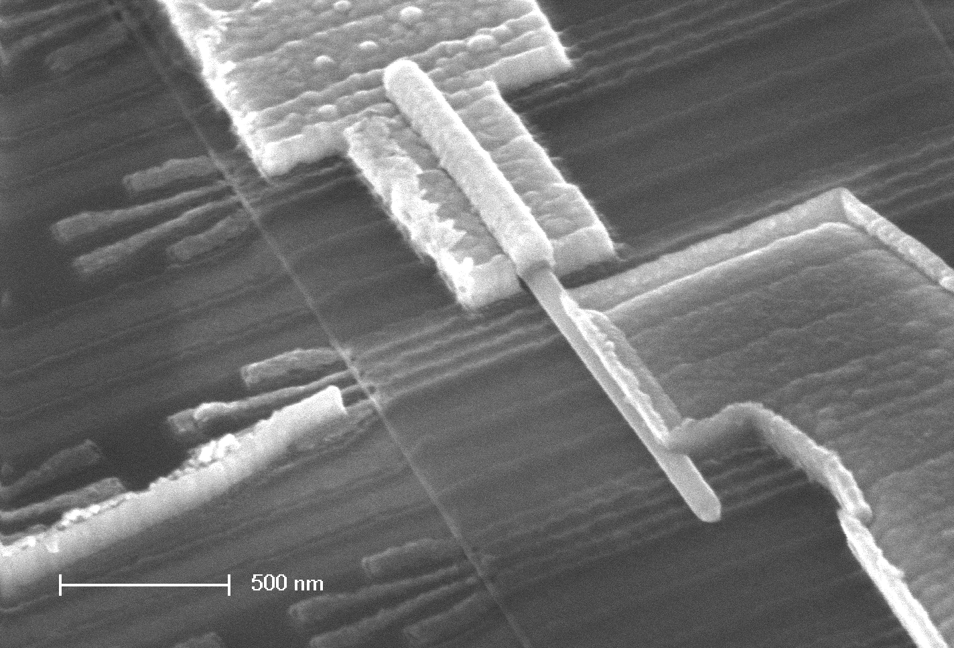
Ti/Au
NbTiN
InSb
nanowire
1 micron

Slide 47
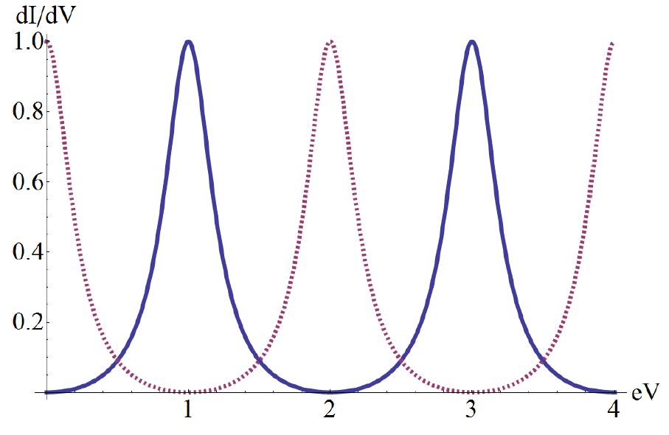
Tunneling experiment
A
N
superconductor
nanowire
Topological Superconductor
Tunneling into a Majorana bound state:
Resonant Andreev current!
Zero bias peak, 2e²/h conductance
Law, Lee & Ng PRL 2009

Slide 48



Slide 49
Gates can be used to change the length of nanowires , effectively moving the MF and breaking into segments and fusing it back together
In a T-junction, these processes can be used to exchange two MFs connected by a topological region or not

Slide 53


Slide 54


Slide 57
Advantages of Topological Devices
      New phenomena: still a lot of fundamental physics left to do
      Determine if Majorana fermions (MFs) exist
      Determine if what look like MFs have non-Abelian statistics
      Develop techniques --- interferometry, imaging, etc. --- to track MFs
      Topological materials/interfaces: still a lot of materials research to do
      Find and study new topological materials predicted
      Improve topological materials --- determine what properties are important
      Interfaces are critical --- everything depends on Hamiltonian engineering
      Topological device technology: still a lot of engineering to do
      Determine best architectures and device designs
      Develop schemes for braiding MFs
      Develop schemes for reading parity and braiding operations
      Explore entangled braiding/readout schemes
      Interfacing MF qubits to conventional electronics

Slide 58
Advantages of Topological Systems in Quantum Computing
      Need fewer qubits – less error correction
      Small, cumulative perturbations can quantum states to decohere and introduce errors in the computation, but such small perturbations do not change the braids' topological properties.
      The cost: Factoring a 1000-bit number requires about 10⁴ qubits without error correction. With error correction, the figure would rise to about 10⁷ bits, a scale-up of x1000.
      Less competition
      Many universities and industries are active in “conventional” quantum computing
      Google (Martinis)
      IBM (Steffen)
      Northrup-Grumman
      Rigetti (Berkeley)
      Yale (Devoret, Schoelkopf)
      Berkeley (Clarke, Siddiqi)
      ETH Zurich (Waldraff)
      Waterloo (IQC)
      LPS (Palmer, Osborn)
      Fewer are big players are active in “topological” quantum computing
      Microsoft Station-Q
      D-wave Systems
      Delft (Kouwenhoven)
      Chalmers (Marcus)
      Illinois (DVH, NM, JE, TH, SV)

Slide 60
Steps to implementing Majorana fermions
Requirements:
Create MFs
Image MFs --- where are they localized?
Braiding
  Exchange MFs --- move physically
  Interact MFs --- hybridization (“effective braiding”, “braiding without braiding”, “fake braiding”)
  Project MFs via the readout process
Parity readout
Control of parity lifetimes --- “quasiparticle poisoning”
Quantum computing architecture --- surface codes, etc.
Demonstrate quantum supremacy

